Slide 1
Decarbonisation Collective
Decarbonisation Collective
Data-Driven London Decarbonisation: A Collective Effort for London's Net-Zero Future
Dhivya, Kristina, Stephanie

Slide 2
01 // LONDON'S BUILT ENVIRONMENT
Decarbonisation Collective
Buildings account for nearly 70% of London's total carbon emissions.
BUILDING EMISSION SHARE
70%
London's built environment consists of over 3 million diverse properties, ranging from historic Victorian terraces to modern commercial skyscrapers. This vast and aging building stock presents a massive decarbonisation challenge.
Retrofitting these structures requires identifying precise emission patterns, energy inefficiencies, and heating demands across boroughs to prioritize high-impact interventions.
CRITICAL PATHWAY
Addressing the heating inefficiencies of these 3 million properties is the absolute priority for municipal decarbonisation efforts.
Decarbonisation Collective

Slide 3
Decarbonisation Collective
03 // THE PROBLEM
Warmer homes for all, delivered through data-driven triage.
London wants warmer homes for all — homes that hit the EPC C standard, lift households out of fuel poverty, and move the city towards net zero. The hard part is triage: millions of properties, finite budgets, and vulnerable low-income households.
THE TRIAGE CHALLENGE
The challenge brief puts it plainly: "How data can help deliver retrofit for low-income Londoners." So the real question is not "which homes are inefficient?"
It's four questions at once:
01. Need
Which homes need physical retrofit work?
02. Benefit
Which properties would benefit the most?
03. Funding
Who should pay for these upgrades?
04. Action
What exactly should be done first?
THE DECISION FUNNEL (LBSM v2)
A single, explainable funnel built on the London Building Stock Model to process every borough property.
ALL BOROUGH PROPERTIES
1. PRIORITY TIER
2. FUNDING ROUTE
3. RECOMMENDED MEASURE
4. NAMED OWNER
Decarbonisation Collective

Slide 4
Achieving net-zero requires coordinated action
across four key stakeholder levels.
The Londoner (Homes)
The Corporation (Workplaces)
Residents seeking to reduce household energy bills and adopt low-carbon heating solutions.
Businesses aiming to meet ESG targets and retrofit commercial office spaces.
The Councillor (Local Authority)
The GLA (City-wide)
Local representatives designing targeted neighborhood interventions and managing local budgets.
City Hall setting strategic London-wide policies and tracking overall net-zero progress.
Decarbonisation Collective

Slide 5

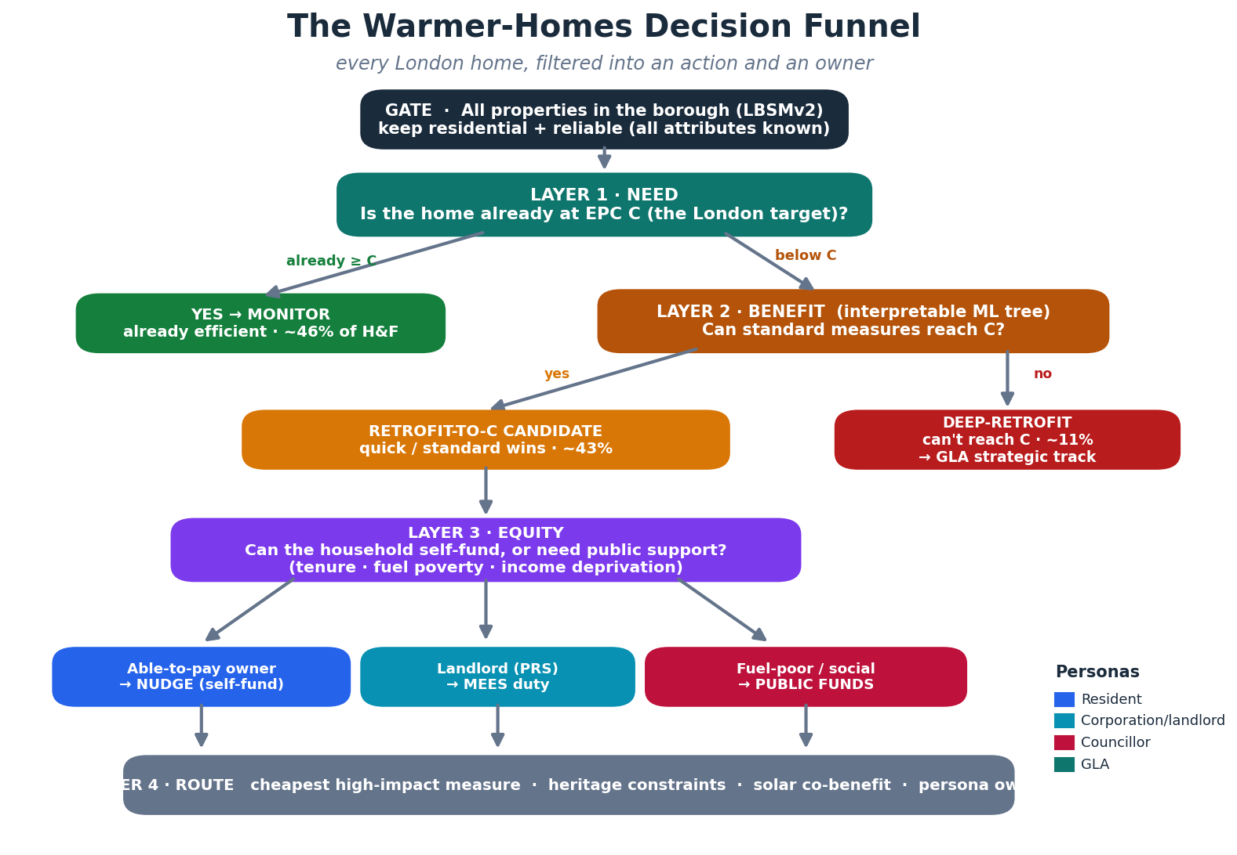
Decarbonisation Collective

Slide 6
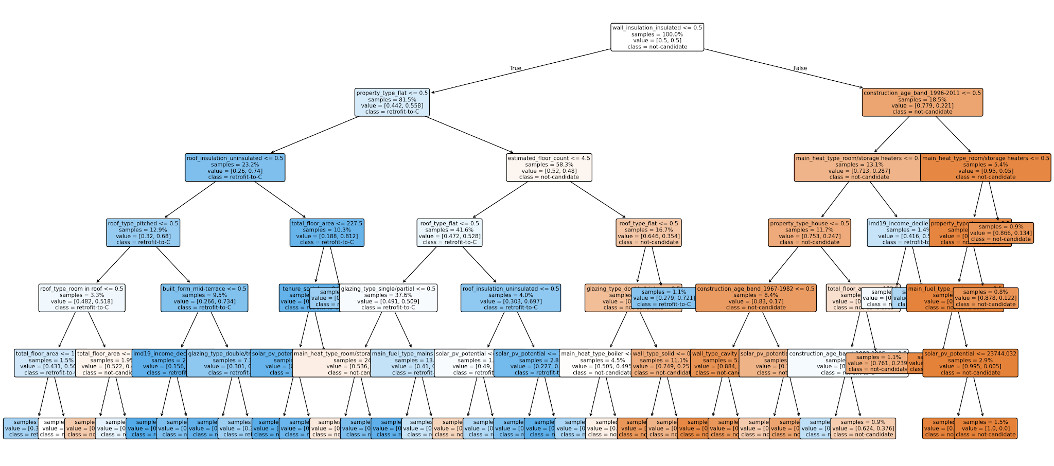
Decarbonisation Collective

Slide 7
Decarbonisation Collective
"Data-driven collaboration is the key to unlocking London's net-zero future."

